Slide 1
Political Considerations in the Decision of Chinese SOEs to List in Hong Kong
Originated from：Mingyi Hung, T.J. Wong, Tianyu Zhang
Presented by: Xizi Yu

Slide 2
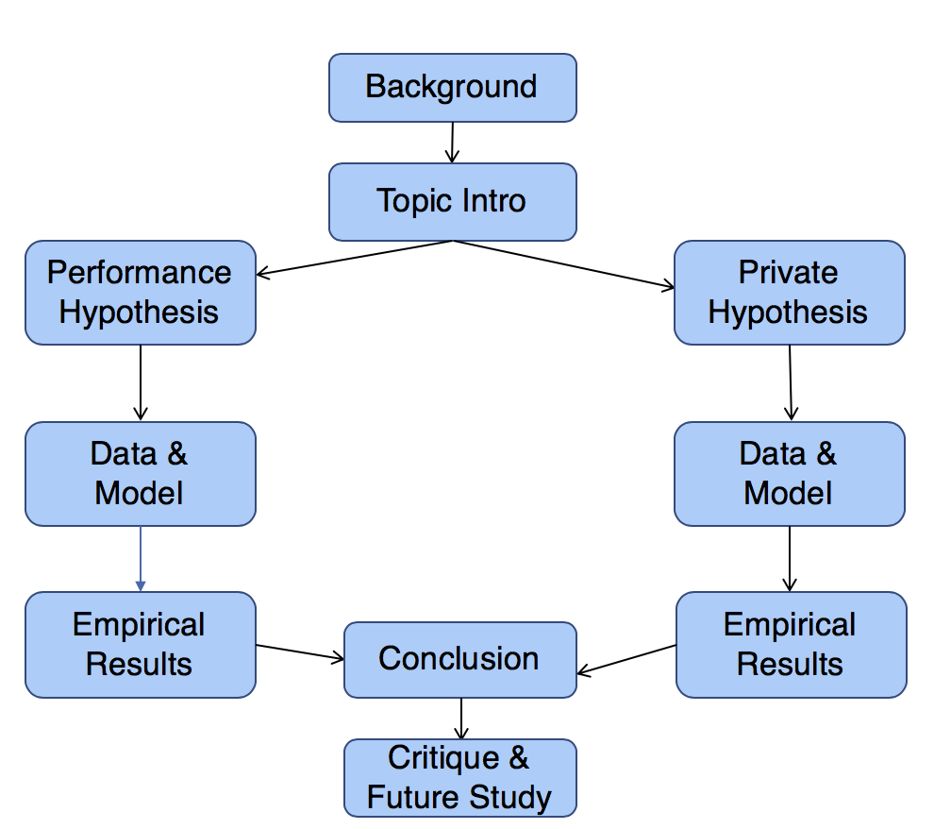
Agenda

Slide 3
Background
SOE: State-owned enterprise.
Many SOEs are realizing privatization through listing in developed market overseas in the past decades.
China has launched a privatization program of unprecedented magnitude in global financial markets.
Based on the strong tie between business and government in China, the authors want to explore the role of political connections in SOE’s decisions about overseas listing.

Slide 4
Topic & Hypothesis
Why Chinese state-owned enterprises (SOEs) with strong political connections are more likely to list overseas than non politically connected firms?
Politically Connected SOEs
Overseas Listing (Hong Kong)
Performance hypothesis:
Better enterprise performance
or
Private benefits hypothesis:
For private political benefits of the managers
*Politically Connected SOEs refers to those SOEs whose CEO or Chairman is a current or former government bureaucrat. Other SOEs will be considered as non-politically connected.

Slide 5
Data
1018 Chinese SOEs listed domestic and overseas from 1992 to 2005. 939 are listed only on domestic stock exchanges (Shenzhen and Shanghai stock exchanges). Among the remaining 79 firms listed overseas, 78 are listed in Hong Kong, 14 in New York (14 also list in Hong Kong), and 5 in London(4 also list in Hong Kong).
Hong Kong is treated as overseas market because Hong Kong has a separate jurisdiction from China. In addition, the legal and financial environment in Hong Kong resembles those of other foreign markets.

Slide 6
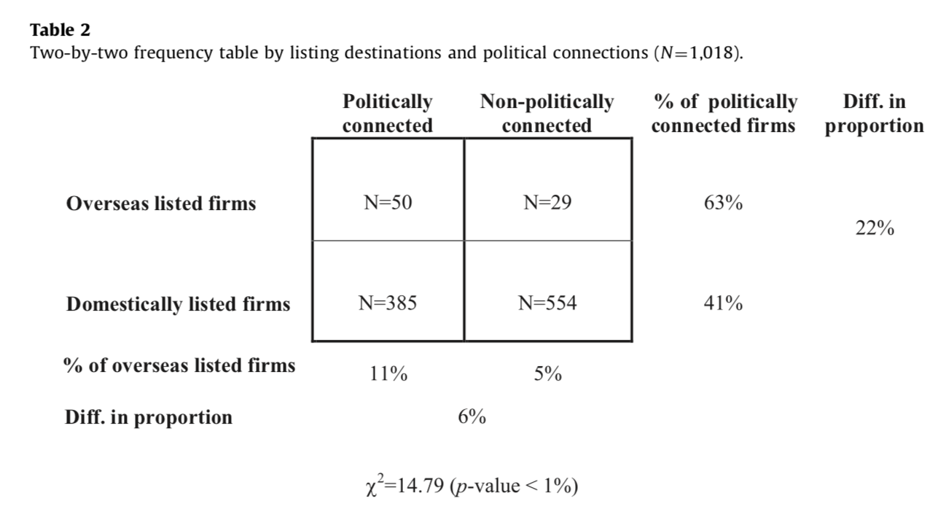
Factoring Political Connection in Listing Decision (Descriptive Evidence)

Slide 7
Performance Hypothesis
Politically connected firms exhibit better performance than non-politically connected firms subsequent to the overseas listing.
Logic Behind：
Firms may benefit financially through their political ties in the form of direct or indirect government subsidies.
2. In addition, the most ambitious bureaucrats will want to work for the best companies.

Slide 8
Data
Pre-listing firm characteristics:
Ultimate ownership
Background information on executives and boards of directors
Financial information from the IPO prospectuses
2. Post-listing performance
Financial and stock price from Worldscope database and from China Security Market and Accounting Research(CSMAR) database.
Accounting-based measure: changes in profitability;
changes in return on sales($∆$ROS), changes in return on assets($∆$ROA)
Market-based measure: stock return-market index;
cumulative market-adjusted returns (CAR)

Slide 9
Regression Model
Bonding effect of overseas listing among politically connected firms is ${{({β_{1}+β}_{2}+β}_{3}−β}_{2})=$ ${β_{1}+β}_{3}$ .
Bonding effect of overseas listing among non-politically connected firms is $β_{1}$.
$β_{3}$ captures the incremental bonding effect among politically connected firms relative to non-politically connected firms.
Performance change among firms that are overseas listed and politically connected is ${({β_{1}+β}_{2}+β}_{3}$).
Performance change among firms that are overseas listed and non-politically connected is ($β_{1}$).
${β_{2}+β}_{3}$ captures the difference in post-listing performance between politically connected and non-politically connected firms among overseas listed SOEs.
Performance hypothesis predicts ${β_{2}+β}_{3}$ to be positive.

Slide 10
Two-stage Model
One concern is that overseas listings is endogenous.
Instrumental variable approach: find instruments that are correlated with the endogenous variables(overseas listing) but exogenous(uncorrelated with error terms), then estimate a first-stage model.
Use predicted value of overseas listing in the place of this variable in second-stage.
Below are three instruments:
Provincial legal environment
Herfindhal index (competitiveness of an industry)
Central SOE

Slide 11
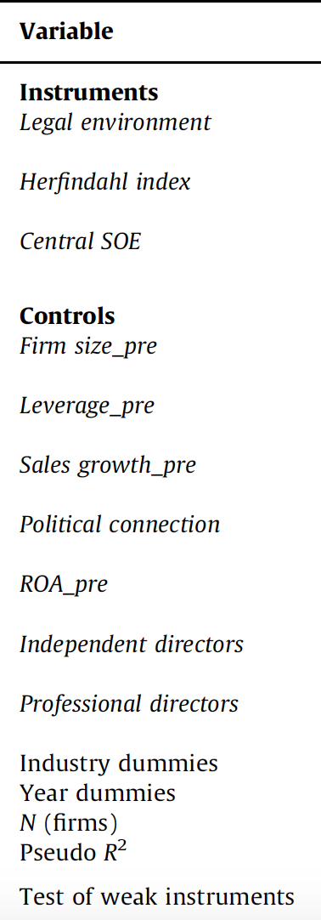
First-Stage Model
The coefficient on legal environment is significantly positive at a P value less than 1%.
The coefficient on political connection is significantly positive at a P value less than 10%, which is consistent with our observation that politically connected SOEs are more likely to list overseas.
F-statistic equals to 23.92, which indicates there is no weak-instrument problem, since the critical value for three instruments is 12.83.

Slide 12
The coefficient on overseas listing $β_{1}$is significantly positive, indicating that overseas listing is associated with increased profitability and greater post-listing performance for firms without political connections.
$β_{3}$ is significantly negative, indicating that the bonding effect of listing overseas for politically connected firms is actually less than for non-politically connected firms.
${β_{2}+β}_{3}$ shows how much politically connected firms will outperform non-politically connected firms after listing. ${β_{2}+β}_{3}$ are significantly negative at a P value less than 10% in all models, except for OLS model using CAR as dependent variable.
The results are inconsistent with performance hypothesis.

Slide 13
Empirical Results
Overseas listing is associated with increased profitability and greater post-listing stock performance for firms without political connections.
This is consistent with prior studies suggesting that listing overseas has bonding effects which improve firm performance.
The improvement in post-listing performance associated with overseas listing is reduced for politically connected firms.
Contrary to our performance hypothesis, among overseas listed firms, politically connected firms underperform non-politically connected firms subsequent to listing.

Slide 14
Private Benefits Hypothesis
Politically connected firms are more likely to list overseas because their managers are using overseas listing as a mechanism to generate private political benefits.
Logic Behind：
Due to the strong tie between business and government in China, an executive position in a large SOE may lead to a promotion to a senior government position in China.
For example, Xiao Yaquing, the Chairman of Aluminum Corp. of China (Chinalco) was appointed deputy secretary-general of the State Council in February 2009, after the firm was listed in Hong Kong.

Slide 15
Data
Political media visibility:
Political media visibility, such as receiving coverage in high-level political media outlet is very important to connected managers (promotion).
Chinese version of the People’s Daily: official Communist Party newspaper
A dummy variable indicating whether the firm's chairman or CEO has non-negative news in People's Daily with 5 years following listing.
Political promotion:
Use various news databases and internet by searching the names of managers and the key words such as promotion.
A dummy variable indicating whether the chairman or CEO was promoted to a senior government position.

Slide 16
Model
Overseas listing is endogenous and the two-stage model is applied.
$β_{1}$ indicates that the effect of overseas listing on political benefits.
The private benefits hypothesis predicts $β_{1}$to be positive.

Slide 17
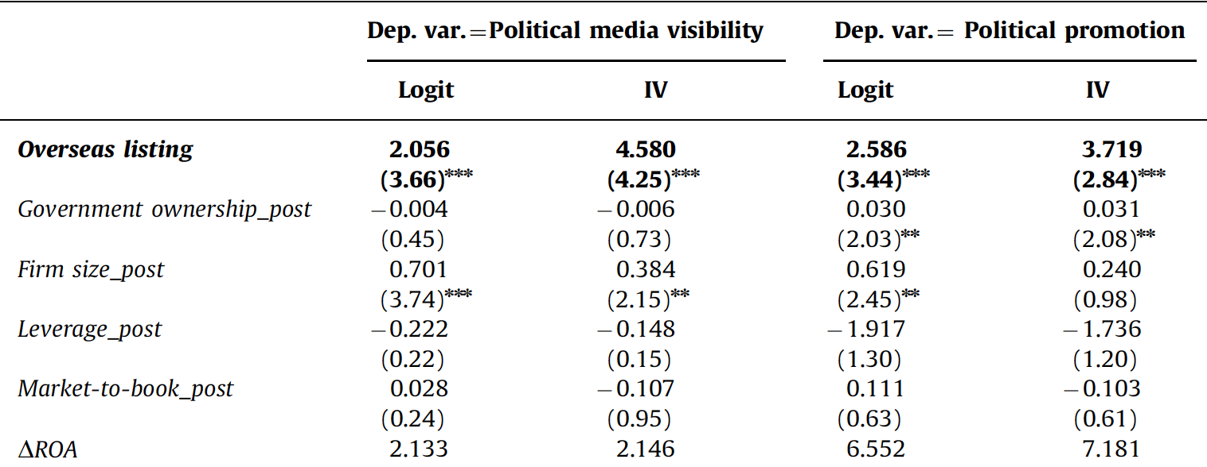
Statistics
The coefficient of overseas listing is significantly positive at a P value less than 1% in all models.
Among politically connected firms, managers of overseas listed firms are more likely to receive recognition in media or a promotion.
For the Over-identifying restrictions test, both statistics are significant for the model using political promotion as dependent variable.

Slide 18
Empirical Results
Consistent with the private benefits hypothesis, politically connected managers use overseas listing to receive political recognition and promotion and therefore more willing to list overseas.
This result also helps explain why politically connected firms underperform non-politically connected firms after overseas listing. The reason is that managers of connected firms are rent seekers, so they only care about their private benefits and don't care about performance.

Slide 19
Additional Analysis
Analysis of sales growth prior to listing
Provide further evidence on the reason that politically connected firms do not exhibit better performance than non-politically connected firms.
The analysis finds that among overseas listed firms, the average sales growth for the politically connected firms is significantly lower than that for the non-politically connected firms.
Analysis of earnings management prior to listing
Hypothesis: Politically connected firms are more likely to manage their profitability prior to overseas listing, but perform poorly subsequent to the listing.
The analysis finds that there is no significant difference in earnings management prior to listing between politically connected and non-politically connected firms.

Slide 20
Conclusion
1. Consistent with the private benefits hypothesis, managers of politically connected firms are more likely to receive recognition in the political media or a promotion to a senior government position than are managers of domestically listed firms. Thus, this finding explains why more politically connected SOEs are listing overseas.
2. Instead of the performance hypothesis that politically connected firms are listed overseas because of their superior performance, the evidence suggests that connected firms are rent seekers and underperform non-politically connected firms.
3. The additional analysis shows that among overseas listed SOEs, the average sales growth during the pre-listing period is significantly lower for politically connected firms than for non-politically connected firms.
4. In addition, there is no significant difference in earnings management prior to listing between politically connected and non-politically connected firms.

Slide 21
Critique & Future Study
Sample size; other hypothesis
Anti-corruption Campaign: “cracking down both tigers and flies”.
Chinese government are performing anti-corruption act and promoting SOE reform.
Private benefits hypothesis
Post-reform performance of China’s SOEs
Role of political connections in privately owned enterprises

